Slide 1



Patient Care Coordination Domain Update Tone Southerland, Ready Computing, Inc. Laura Langford, Intermountain Healthcare
Webinar Series 2015
http://ihe.net/Webinars/
Notes:
Tone

Slide 2
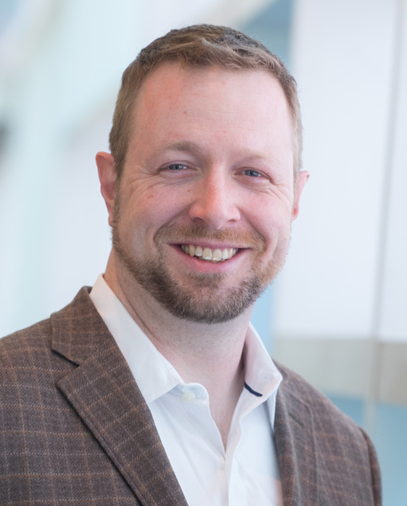
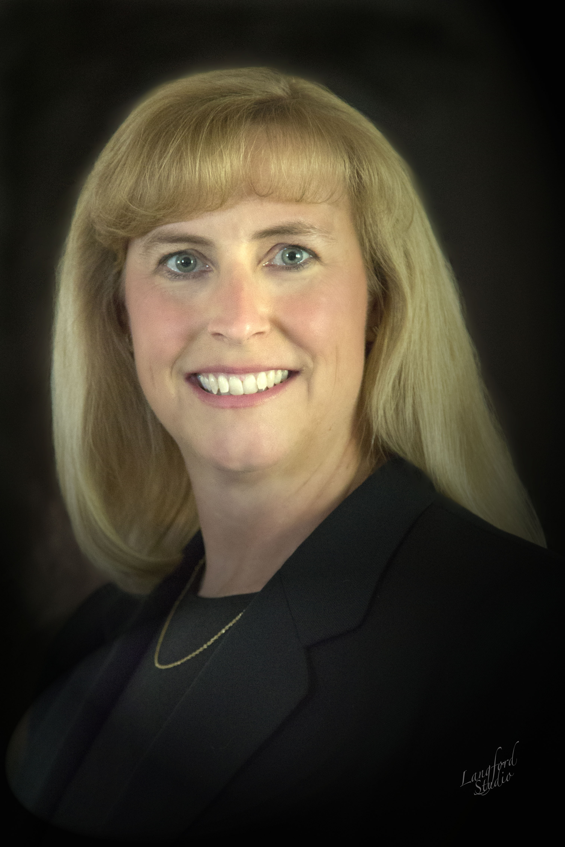
Today’s Presenters
Tone Southerland
Planning Committee Co-Chair, IHE PCC
Director of Implementation, Ready Computing, Inc.
Laura Langford, PhD, RN
Planning Committee Co-Chair, IHE PCC
Nursing Informatics, Intermountain Healthcare
Notes:
Tone and then hand off to Laura

Slide 3
Domain Overview Agenda
Overview and History
Vision and Mission
Strategic Goals
Profiles & Technical Frameworks
Existing Profiles
New Profiles
How to Participate in PCC
Q&A Session
Notes:
Laura

Slide 4
IHE Domains
Dental
2010
Radiology
1998
Pharmacy
2009
Cardiology
2004
Quality, Research, and Public Health
2006
IT
Infrastructure
2003
Radiation
Oncology
2004
Eye Care
2006
Lab
2004
Anatomical
Pathology
2006
Patient Care
Coordination
2004
Patient Care
Devices
2005
Notes:
Laura
Mention this webinar is focused on PCC, for more general info on IHE International and it’s mission and vision see ihe.net

Slide 5
PCC History
IHE PCC was formed in 2004
The committee’s first profile was also IHE’s first content profile: XDS-MS. The profile was delivered in September of 2005 for Trial Implementation.
Since then, PCC has created 24 content profiles, 5 workflow profiles, and 5 integration profiles.
The IHE PCC Technical Framework is used in national and international programs in the US, France, Italy, China, Saudi Arabia, and across Europe.
Notes:
Laura
China: http://www.ncbi.nlm.nih.gov/pmc/articles/PMC3243277/

Slide 6
PCC Vision and Mission
Vision: The vision of Patient Care Coordination is to continually improve patient outcomes through the use of technology connecting across healthcare disciplines and care paths.
Mission: The mission of Patient Care Coordination is to develop and maintain interoperability profiles to support coordination of care for patients where that care crosses providers, patient conditions and health concerns, or time.
http://wiki.ihe.net/index.php?title=Patient_Care_Coordination
Notes:
Laura
Completed vision casting at 2014 Summer F2F meeting
Vision key words: continually, across
Link to wiki page for reference - http://wiki.ihe.net/index.php?title=Patient_Care_Coordination

Slide 7
PCC Strategic Goals
Content
Coordinate with external standards development organizations (SDOs) to develop and promote the use of content templates
Develop strategies to support multi-level content template guidance to benefit the global community
Workflow
Develop new profiles by reaching outward to other IHE domains to coordinate workflows across care paths
Develop white papers exploring new areas that could benefit from standards based interoperability guidance
Nursing
Examine and understand the benefit of IHE profile work in the nursing space by partnering with nursing organizations and initiatives
Develop profiles and white papers to support and explore various nursing specific workflows
Notes:
Laura
Content:
re-evaluating our role here
Workflow:
proactive in working with other domains
4 profile proposals received in 2014 that were “cross-domain”
Nursing
History of subcommittee
Nursing needs related to care coordination and MU objectives

Slide 8
PCC Scope
Scope
General clinical care aspects such as document exchange, order processing and coordination with other specialty domains
Workflows and integration needs that are common to multiple specialty areas
Sponsors
Health Information and Management Systems Society (HIMSS)
American College of Physicians (ACP)
Countries actively involved in committees
United States
Canada
Italy
France
Netherlands
Notes:
Laura
Confirm with Celina that ACP is still our sponsor, and how they contribute – yes they are at least for now.

Slide 9
Profiles & Technical Frameworks Overview
IHE Technical Frameworks
http://ihe.net/Technical_Frameworks/#pcc
IHE Profiles developed by PCC
http://wiki.ihe.net/index.php?title=Profiles#IHE_Patient_Care_Coordination_Profiles
Learn More
Webinar Series http://ihe.net/Webinars/
Notes:
Laura
- Jump out to browser and show ihe.net site
Archived webinars available on ihe.net for PCC profiles
Note on availability of older webinar videos

Slide 10
Profiles & Technical Frameworks Existing High Uptake Profiles
Medical Summaries (XDS-MS)
Discharge and Referral Summaries exchanged between providers
EHR and HIS solutions
Ensures adequate exchange of data for referrals and transitions of care between inpatient and ambulatory settings.
Emergency Department Referral (EDR)
Enhances XDS-MS to support “Heads-up” call to ED
EHR, EDIS, HIS, HIE
Provides critical data needed in ED visits
Exchange of Personal Health Records (XPHR)
Exchange Clinical Summary data with patients
EHRs, PHRs, Patient Portals
Ensures that patients have updated lists of healthcare providers, problems, medications, allergies, immunizations, lab results, procedures and encounters
Notes:
Tone
Many profiles share same section and entry templates
Speak to what it means to be high uptake
IHE Connectathon participation
Real world implementations
Both of these on a global scale

Slide 11
Profiles & Technical Frameworks Existing Profiles for Clinical Decision Support
Query for Existing Data (QED)
Access to clinical data (problems, medications, allergies, results, procedures, encounters)
EHR, CDR, HIS, Registries
Provides access to clinical data for use in quality measurement, reporting, clinical decision support, and research
Care Management (CM)
Supports communication to specialized care delivery systems for disease management
Request for Clinical Guidance (RCG)
Access to Clinical Decision Support
EHR, other HIT Systems
Provides standardized interface to access clinical decision support as a service
Retrieve Clinical Knowledge (RCK)
How Health IT systems, Personal Health Records, and HIEs can retrieve clinical knowledge on a topic suitable for presentation to a clinician or patient
Notes:
Tone
Lower uptake, perhaps ahead of their time
Plans to adapt QED to support FHIR in the future

Slide 12
Profiles & Technical Frameworks Existing Profiles for Emergency Care
Transport Record Summary Profiles
Documents care that occurs during patient transport
Fixed wing, helicopter, ambulance
EHR, EDIS, Transport Team
Emergency Department Encounter Summary (EDES)
Documents care in an ED encounter
EHR, EDIS, other HIT Systems
Provides critical information for patients and providers after an ED visit.
Notes:
Tone
Transport Record Summary:
- Emergency Department Transport Summary (ETS)
- Interfacility Transport Summary (ITS)
Emergency Department Encounter Summary
- Composite Triage and Nursing Note (CTNN)
- ED Physician Note (EDPN)
- Nursing Note (NN)
- Triage Note (TN)

Slide 13
Profiles & Technical Frameworks Existing Profiles for Obstetric, Pediatric
Antepartum Profiles:
Antepartum H&P (APHP)
Antepartum Summary (APS)
Antepartum Laboratory (APL)
Antepartum Education (APE)
Labor and Delivery Profiles:
Labor and Delivery H&P (LDHP)
Labor and Delivery Summary (LDS)
Maternal Discharge Summary (MDS)
Postpartum Visit Summary (PPVS)
Pediatric
Newborn Discharge Summary (NDS)
Immunizations
Immunization Content (IC)
Notes:
Tone
- Call out specifically for pediatric involvement in PCC

Slide 14
Profiles & Technical Frameworks Existing Profiles for Workflow
Cross Enterprise Basic eReferral Workflow Definition (XBeR-WD)
Builds on ITI XDW to manage the workflow related to an eReferral
Cross Enterprise Tumor Board Workflow Definition (XTB-WD)
Builds on ITI XDW to manage the workflow related to managing the multidisciplinary tumor board review
Early Hearing Detection and Intervention-Workflow Definition (EHDI-WD)
Builds on ITI XDW to manage collection and exchange of newborn hearing screening information
Cross Enterprise TeleHome Monitoring (XTHM)
Builds on ITI XDW to manage the clinical process involving chronic patients followed by telemonitoring services
Referral and Order Linking (ROL)
Makes use of new actors (order placer, order filler) to link referrals created in disparate systems
Includes use cases across a variety of health care settings
Perinatal Workflow (PW)
Notes:
Tone
ROL is different as there is no dependency on transport like the XDW based profiles are
PW is cross domain
Reference back to strategic goal of workflow

Slide 15
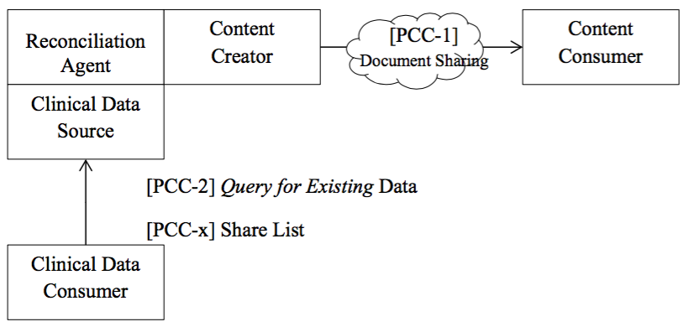
Profiles & Technical Frameworks Reconciliation of Clinical Content and Care Providers (RECON, on FHIR!)
Includes medications, problems, allergies, immunizations, results, observations, goals, care providers
From multiple facilities, over multiple periods of time and different clinical events
Increases patient safety by providing mechanism to reconcile information
Added options for FHIR!
Benefits
Supports US MU program (i.e., most vendors already do it)
Eliminates data re-entry
Notes:
Tone
Originally published several years ago, revamped 2 years ago,
added FHIR options this year – important as it aligns with industry direction and keeps it current

Slide 16
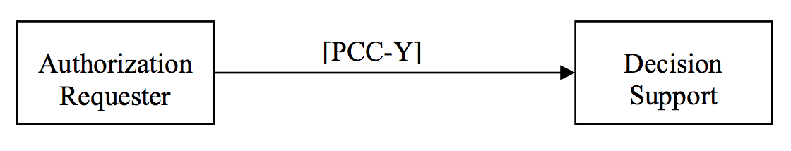
Profiles & Technical Frameworks Guideline Appropriate Ordering (GAO)
Provides appropriateness guidance to systems utilizing decision support interoperability
Includes option for interactive user interface
Cross-profile friendly
Benefits
Downstream usage to validate previously ordered items
Supports a 2017 US law which requires providers to use this type of functionality in order to receive Medicare reimbursements
Notes:
Tone
Conversational Interaction Option
provides interactive user interface through web page
Is on Auth Requester and Decision Support Service actors
Cross profile – eg. RAD SWF, ITI DSG, also LAB and PHARM

Slide 17
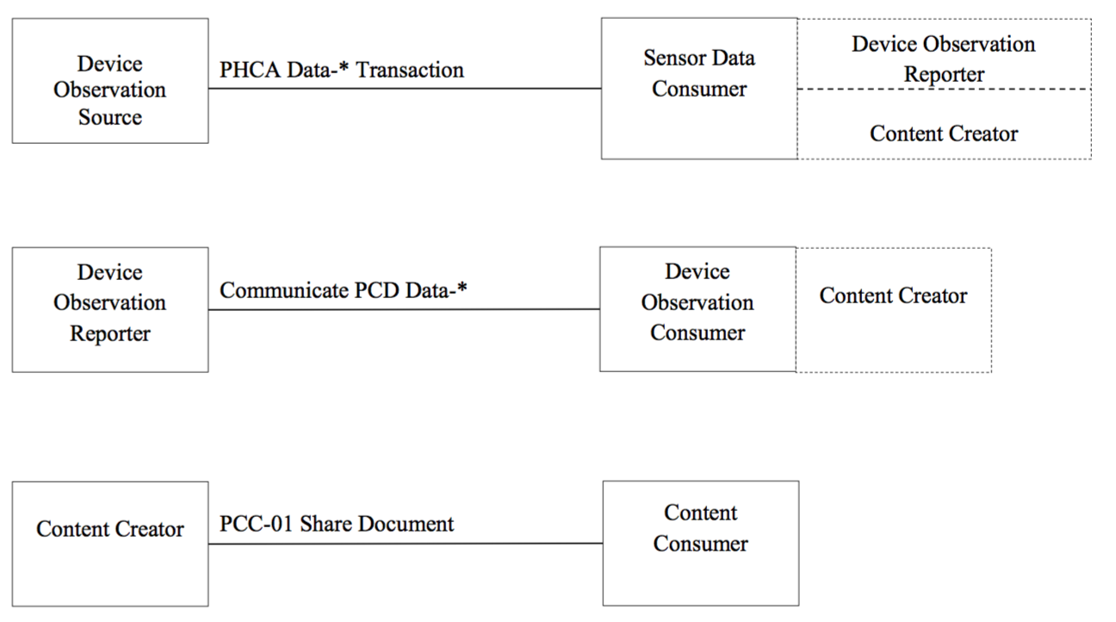
Profiles & Technical Frameworks Remote Patient Monitoring (RPM)
Standardizes measurements taken by Personal Healthcare devices in remote settings
Supports options for PHCA and PCD content formats
Supports actors/transactions from both PCC and PCD domains
Benefits
Reduced interference in patient’s daily life
Reduced expense
Notes:
Tone
PHCA – Personal Connected Health Alliance - formerly Continua
Call out actors from both PCD and PCC in diagram

Slide 18
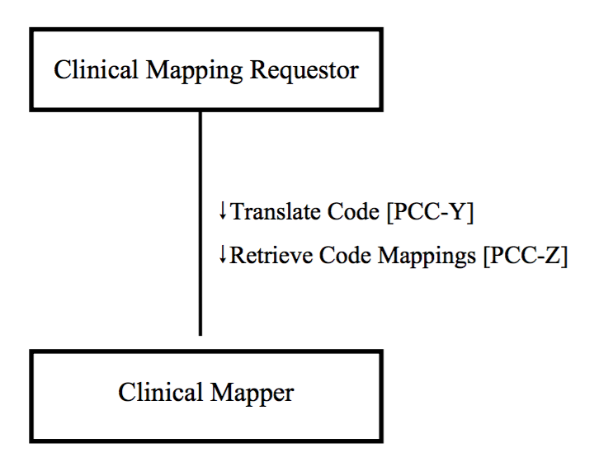
Profiles & Technical Frameworks Clinical Mapping (CMAP)
Manage nomenclature transformations mapping to and from clinical terminologies
Data from a device is available in EHR
Simplifies billing processes
Supports device codes (IEEE) and problems (SNOMED-CT/ICD10)
Benefits
post-conversion data consistency which results in…
Improved patient care and safety
time savings
data entry error reduction
Notes:
TONE
Actor: Clinical Mapping Requestor
The Clinical Mapping Requestor in conjunction with a requesting actor provides a list of terms in a Translate Code Request transaction with:
• Items to be mapped
• Terminology of the items
• targeted terminology for mapping
Actor: Clinical Mapper
The Clinical Mapping Requestor in conjunction with a requesting actor provides a list of terms in a Translate Code Request transaction with:
• Items to be mapped
• Terminology of the items
• targeted terminology for mapping
Transaction: Translate Code
This transaction uses either a REST or SOAP based format to provide a list of clinical items to be mapped to specific clinical terminology equivalents. Projected terminologies include LOINC, SNOMED, and ICD-10.This transaction may require several iterations to get to a match or matches, or a failure: The Clinical Mapper Actor may request additional context from the Clinical Mapping Requester in order to overcome an ambiguous mapping.
Use Cases:
- Medical vital sign observation monitoring discrete data retrospective utilization
- Creating billing documents from clinical encounter documentation
Benefits:
Improved patient safety: b/c data does not need to be manually re-entered
Improved patient care: b/c device observation data would be available to clinicians

Slide 19
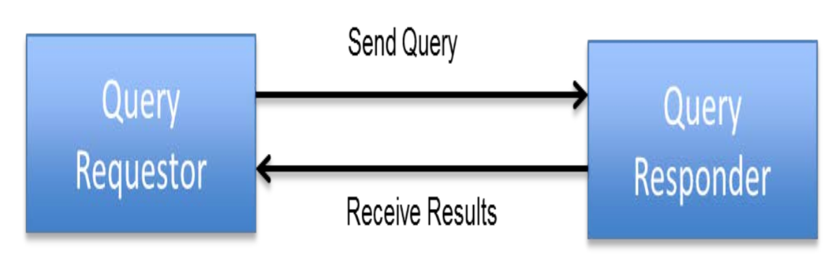
Profiles & Technical Frameworks Data Access Framework (DAF)
US National Extension focused on specific ITI transactions and content modules to meet ONC S&I Framework requirements
Joint collaboration between ONC and IHE USA
Focuses on care coordination
Based on DAF white paper
Supports RESTful approaches
Notes:
Tone

Slide 20
How to Participate in PCC IHE International Membership
Apply for IHE International Organizational Membership
Visit: www.ihe.net/join
Review IHE's 400+ Organizational Members
Participate in IHE Domains & Committees
IHE Organizational Members only
13 Clinical and Operational Domains
Each Domain has one planning and one technical committee
Non-members participate in comment periods and implement IHE Technical Frameworks
Notes:
Laura

Slide 21
How to Participate in PCC PCC Planning Responsibilities
Planning Committee
Develops domain strategy and roadmap
Recruitment
Education
Reviews and recommends IHE profile proposals
Identifies committee priorities and problems
Contact Information
ihe@himss.org
Co-chair: Laura Heermann Langford
Co-chair: Tone Southerland
pccplan@googlegroups.com
IHE.net page:
http://www.ihe.net/Patient_Care_Coordination/
Wiki page:
http://bit.ly/IHEPCCPlan
Notes:
Laura
- Reference strategy meetings at F2F in July 2014

Slide 22
How to Participate in PCC PCC Technical Responsibilities
Technical Committee
Recruitment
Development of IHE Profiles
Maintenance of IHE Technical Frameworks
Projects:
RECON (on FHIR!)
Guideline Appropriate Ordering (GAO)
Remote Patient Monitoring (RPM)
Data Access Framework (DAF)
Incoming profile development for 2015-2016
Contact Information
ihe@himss.org
Co-chair: Emma Jones
Co-chair: Denise Downing
pcctech@googlegroups.com
IHE.net page:
http://ihe.net/Patient_Care_Coordination/
Wiki page:
http://bit.ly/IHEPCCTech
Notes:
Laura

Slide 23
How to Participate in PCC IHE’s Profile Cycle
Committee work follows the IHE Profile Cycle
Annual eighteen (18) month cycle
Each IHE domain has independent schedule
Opportunities for IHE members and non-members to participate in cycle
Detailed overview of IHE Cycle (next slide)
Notes:
Laura
PCC, ITI, QRPH typically meet on same dates
Opportunities
Public comment
Profile proposals
Profile development
Profile testing

Slide 24


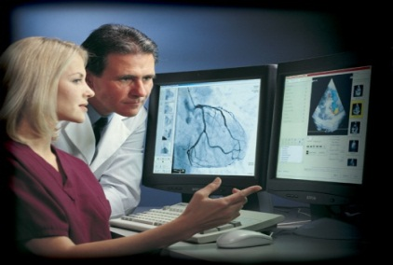
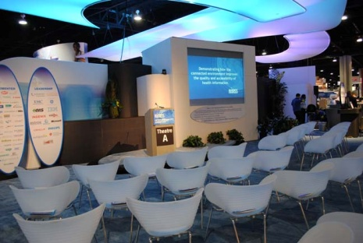

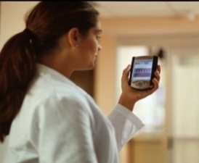
IHE Profiles Drafted & Revised
Test at IHE Connectathons
Trial
Implementation
Posted
Publish in IHE’s Product Registry
Published
For Public
Comment
months 14-18
Demonstrate at a
IHE Technical
Framework Developed
months 6-13
Profile Selection by Committees
IHE Improves, Safety, Quality and Efficiency in Clinical Settings
Install Interoperable products in Clinical Settings worldwide
IHE Call for Proposals Opens
months 1-5
Notes:
Laura
- The IHE process is iterative

Slide 25
IHE Profile Cycle Stages | Participation Status | Open Date | Close Date | Learn More
Call for Proposals | Open | July 2015 | Sept 2015 | ftp://ftp.ihe.net/Patient_Care_Coordination/Templates/IHE_Profile_Proposal_Template-Brief.docx
Profile Selection | Closed | Oct 2015 | Nov 2015 | http://bit.ly/IHEPCCPlan
IHE Profiles drafted in IHE Committees | Closed | Jan 2016 | May 2016 | http://bit.ly/IHEPCCTech
Public Comment | Open | Apr 2016 | Jul 2016 | IHE.net- Documents now in PC IHE’s Wiki- PC Process explained
Trial Implementation Published | Open | N/A | Aug 2016 | http://bit.ly/IHEPCCTF
IHE Connectathon Registration | Open | Aug 2015 | Oct 2015 | IHE N.A. Connectathon Registration
IHE Connectathon Dates | Open | Jan 25-29, 2016 |  | IHE N.A. Connectathon Resources
http://wiki.ihe.net/index.php?title=ITI,_PCC_%26_QRPH_Meetings
Notes:
Laura
I don’t think new dates have been published yet…. http://wiki.ihe.net/index.php?title=Domain_Milestone_Dates

Slide 26
How to Participate Learn More about IHE International
All webinar recordings and slide decks will be posted online
http://ihe.net/Webinars/
Sign up for the IHE International News
Email secretary@ihe.net
Apply for IHE International Membership
http://ihe.net/Join/
Notes:
Laura

Slide 27
How to Participate in PCC Learn More about IHE Connectathons
IHE International Connectathons
http://ihe.net/Connectathon/
IHE NA Connectathon 2016 is Jan 25-29, 2016
http://www.iheusa.org/connectathon.aspx
IHE NA Connectathon 2016 Registration Open: August 2015
Registration:
http://www.iheusa.org/connectathon-registration.aspx
Participant Guidelines online:
http://www.iheusa.org/connectathon-participantresources-guidelines.aspx
Notes:
Laura
There are connectathons around the world, not just NA
http://www.iheusa.org/connectathon-participantresources-importantdates.aspx

Slide 28
Thank you for your attention
Questions?
Notes:
Laura

